Slide 1
INF354
Lecture 5– Services
Theory Lecture

Slide 2
Web services
Web service introduction
A web service is a class (including its methods) that is available over a network (such as the Internet or an intranet)
That means an application running on one computer can use a Web service running on another computer via the Internet or an intranet
It is based on three primary standards:
  WSDL (Web Services Description Language) – an XML-formatted language used to completely describe a Web Service
  UDDI (Universal description, discovery and integration) – an XML-based standard that business use to publish and find Web services
  SOAP (Simple Object Access Protocol) – is data communications protocol for exchanging XML-based messages over a computer network, normally using HTTP (the Web)

Slide 3
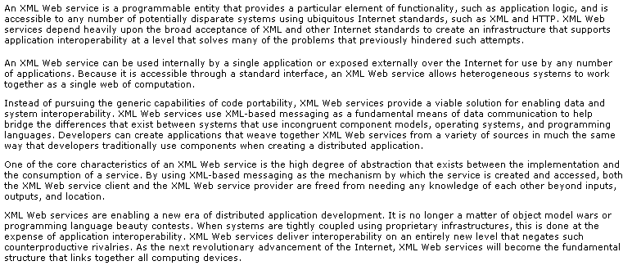
XML Web services
XML Web service overview

Slide 4
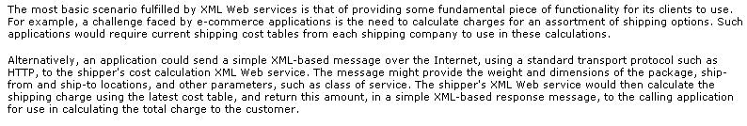
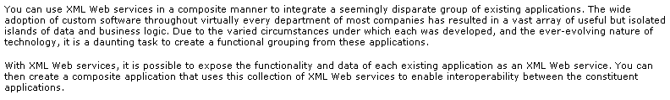
XML Web services
XML Web services examples

Slide 5
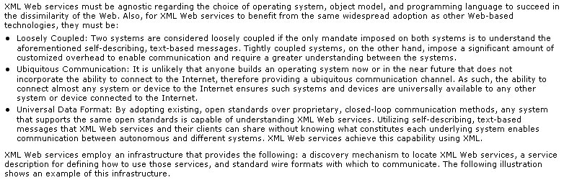
XML Web services
XML Web Services requirements

Slide 6
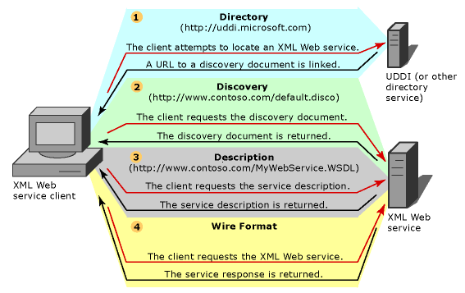
XML Web services
XML Web services infrastructure

Slide 7
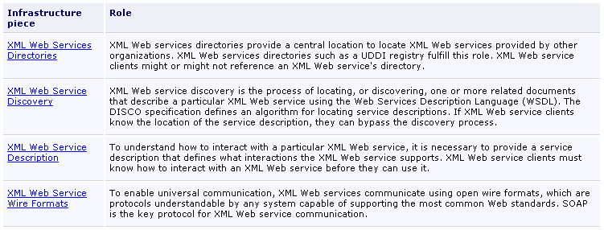
XML Web services

Slide 8
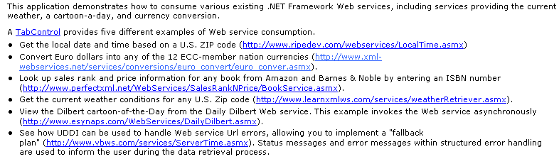
XML Web services
Consuming services

Slide 9
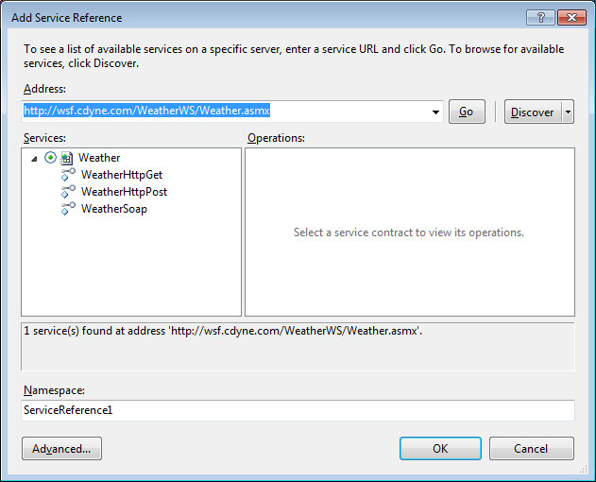
Exercise 1
http://wsf.cdyne.com/WeatherWS/Weather.asmx

Slide 10
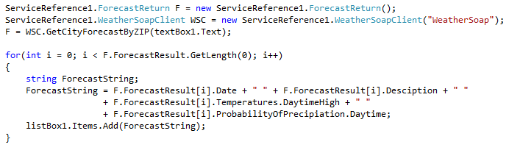
Code Snippets

Slide 11
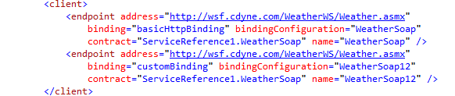
Getting the Endpoint
Open up the App.Config file.
Select one of the name elements as the Endpoint you pass through to the SoapClient.

